Slide 1
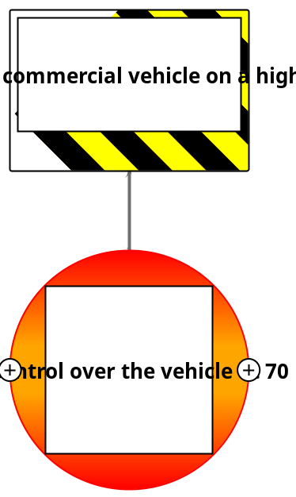
Hazard & Top Event

Slide 2
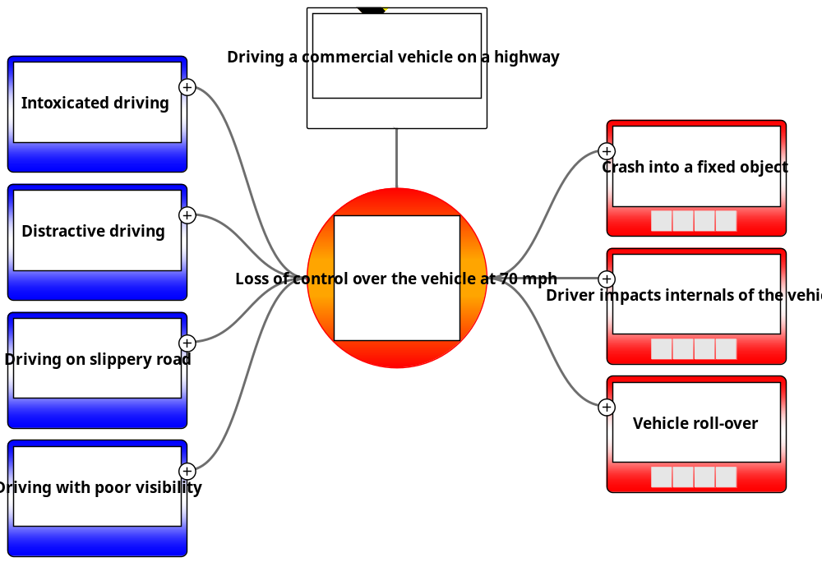
Hazard, Top Event, Threats and Consequences

Slide 3
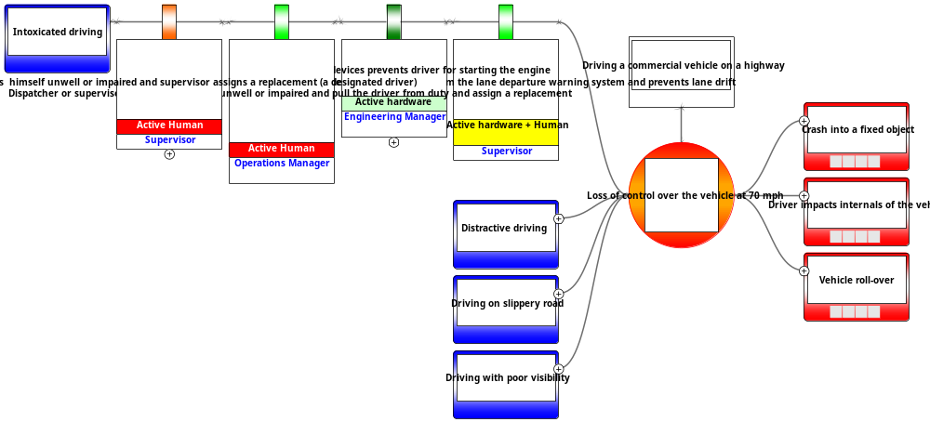
Prevention Barriers for the first Threat

Slide 4
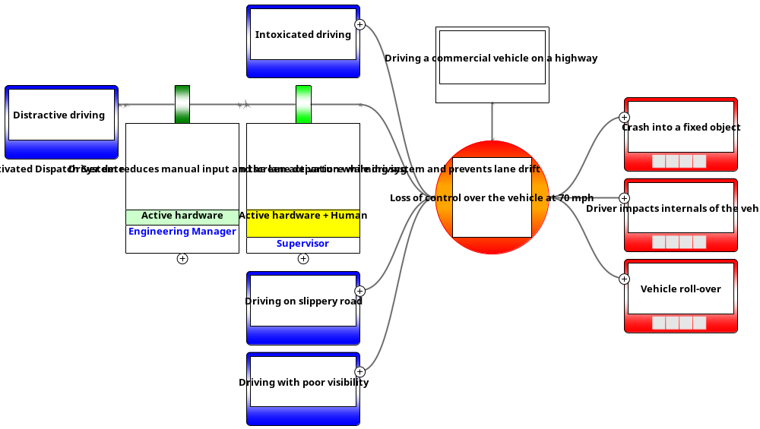
Prevention Barriers for the Second Threat

Slide 5
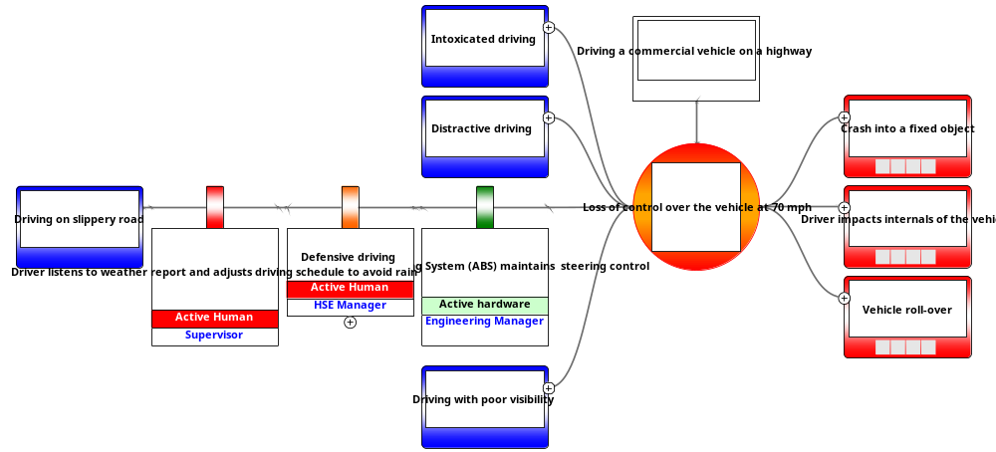
Prevention Barriers for the Third Threat

Slide 6
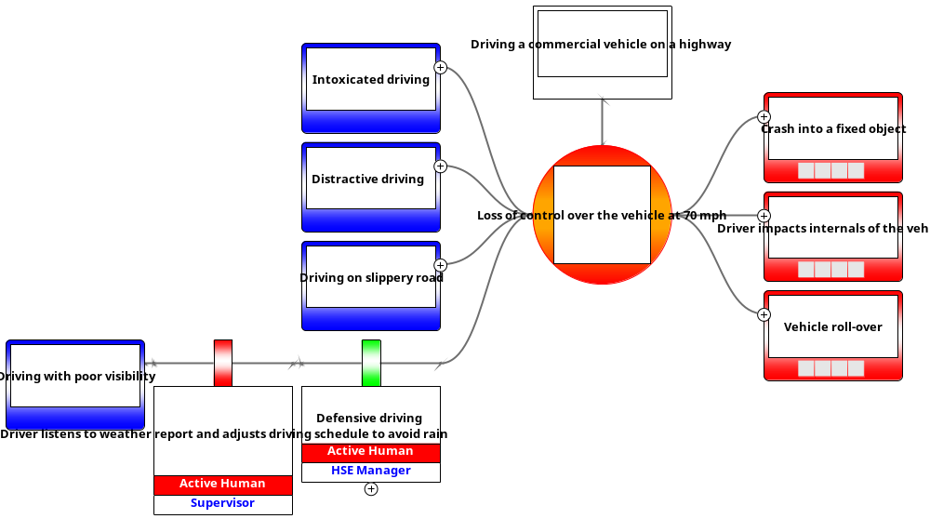
Prevention Barriers for the Fourth Threat

Slide 7
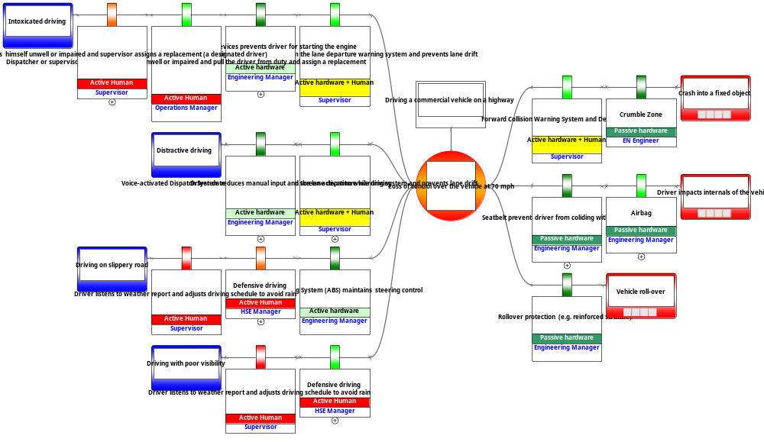
Hazard, Top Event, Threats. Consequences Prevention and Mitigation Barriers

Slide 8
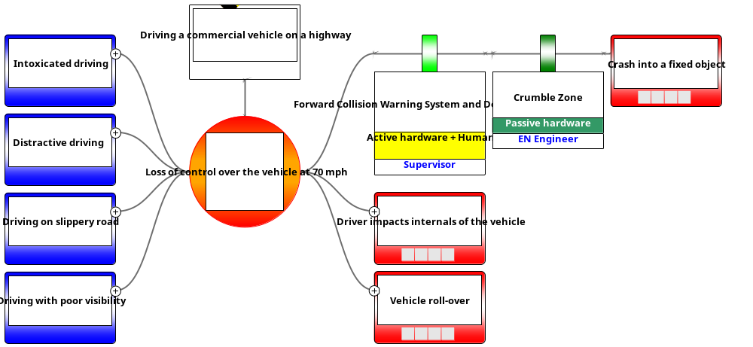
Mitigation Barriers for the First Consequence

Slide 9
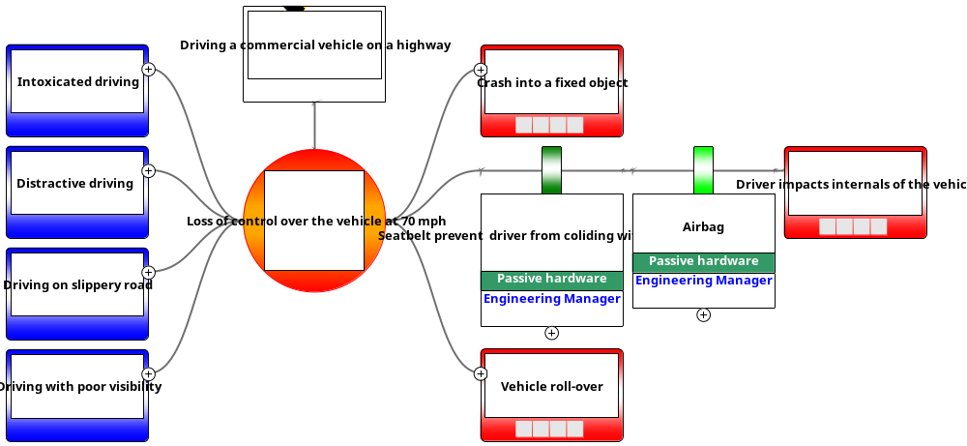
Mitigation Barriers for the Second Consequence

Slide 10
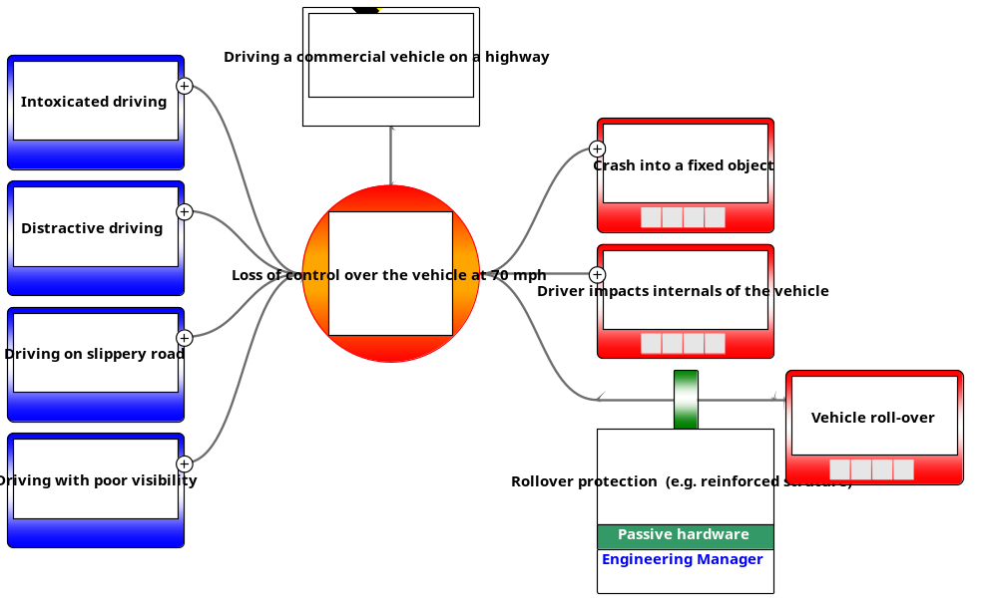
Mitigation Barriers for the Third Consequence

Slide 11
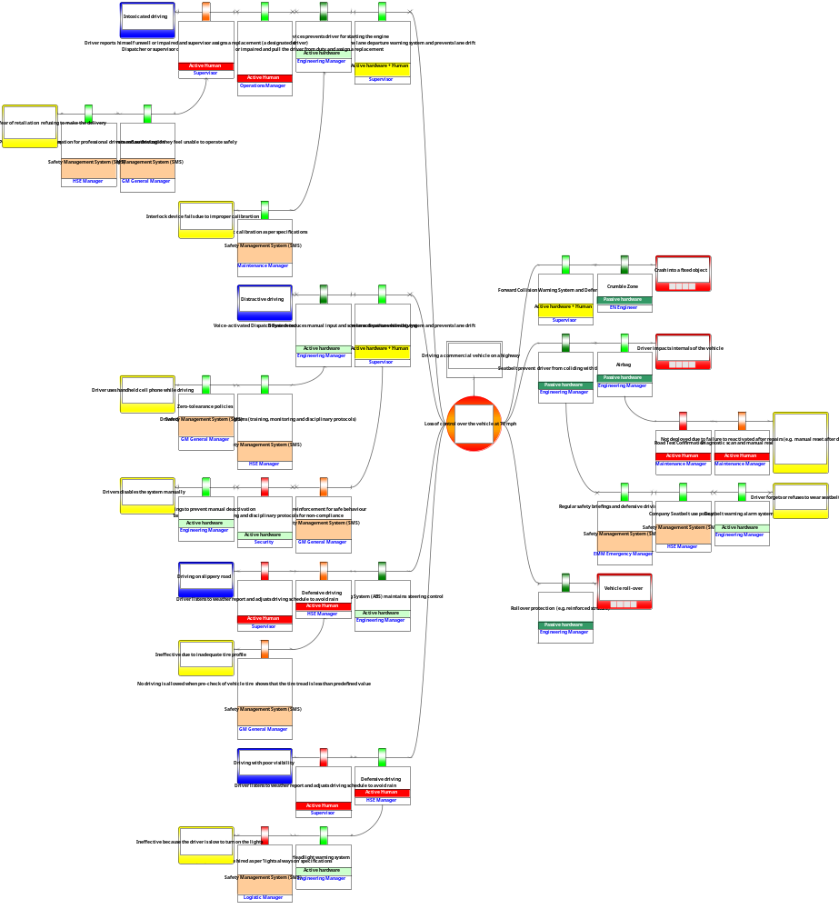
Entire Bowtie

